Slide 1



Data, Structure & Missing Value

Slide 2
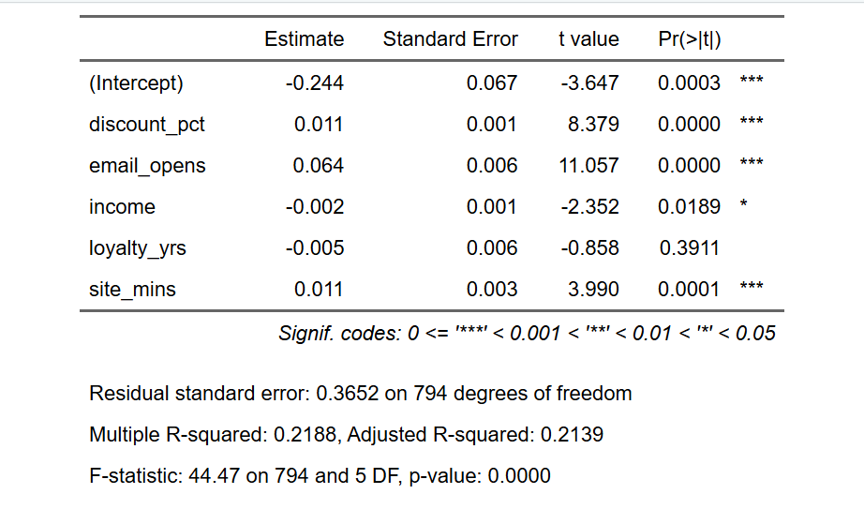
Linear Probability Model

Slide 3
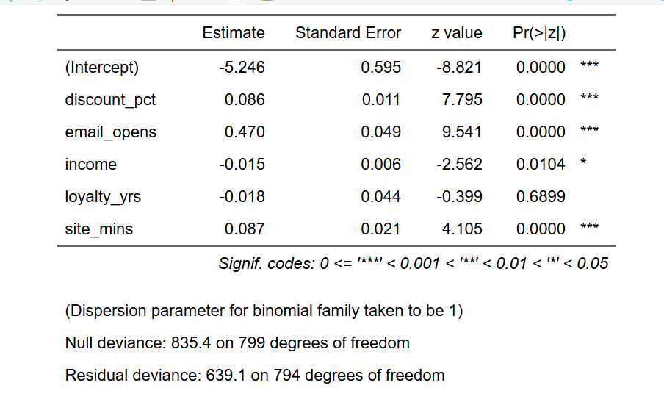
Logistic Model

Slide 4
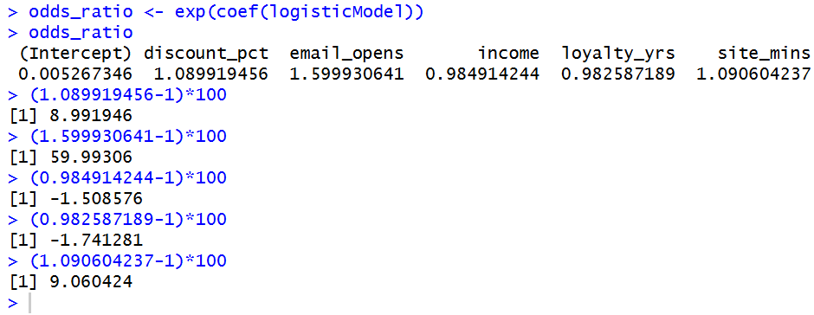
Partial Effect

Slide 5

Prediction of 2 New Customer

Slide 6


Accuracy

Slide 7
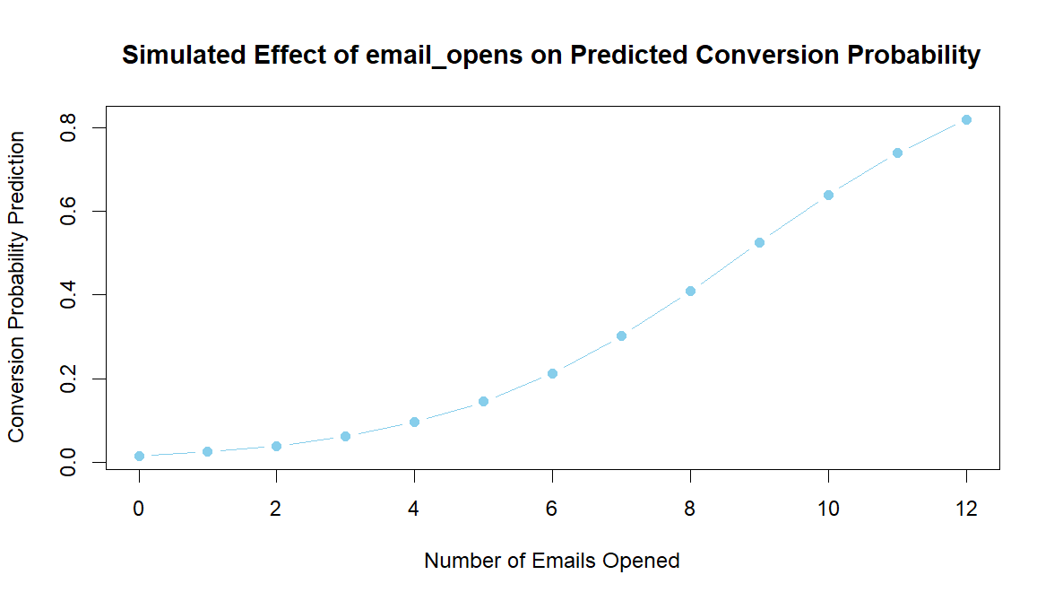
Partial Effect of Emails Opened

Slide 8
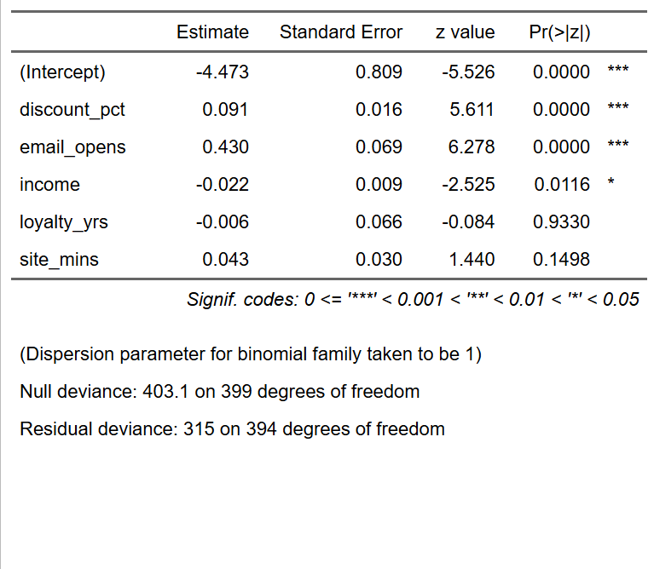
Holdout Method Comparison

Slide 9

Holdout Method Comparison

Slide 10
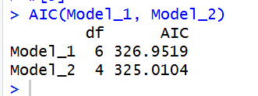
AIC & Comparison

